Slide 1
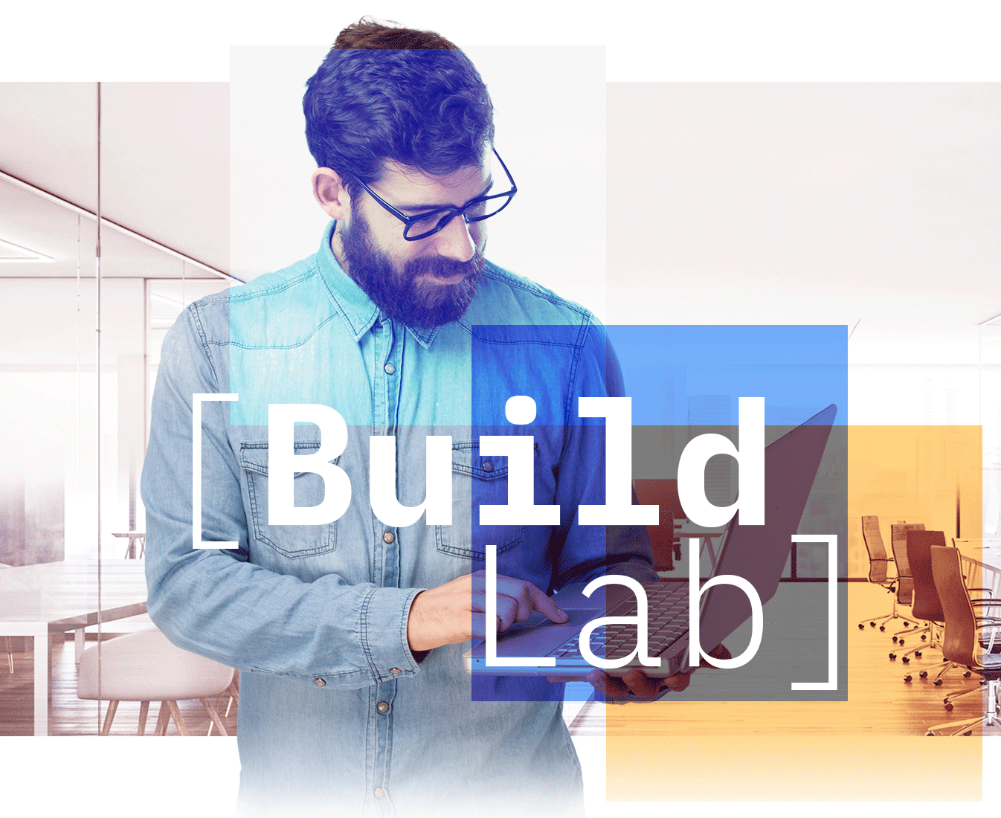


[Ecosystem Engineering | Build Lab Americas]
ScaleWith PoC Architecture
ScaleWith
Social Impact AI

Slide 2





IBM Social Impact GPT - LLAMA
admin
Multi-stage RAG
Model A
Model B
Model C
-5(b)-
S# | Stage 1 Document Enrichment
0 | Upload raw 10k documents to Discovery
1 | Stage 1 search retrieval
2 | Invoke LLM for generating inferences
3 | Use the most suitable model for the task
4 | Model response received by the service
5(a) | Gather enriched docs from stage 1 output
5(b) | Manually upload new, enriched 10k docs to Discovery
 | Stage 2 RAG - Conversational Search
6 | Questions from ScaleWith users
7 | Stage 2 retrieval of uploaded enriched docs from Discovery
8 | Invoke LLM for mapping inference
3 | Assistant uses its embedded LLM
9 | Response as inferred by Watsonx LLM
12 | Response sent back to customer
-5(a)-
0-
-3-
-4-
-2-
Stage 1 code
-1-
watsonx.ai
Watson
Discovery
-9-
-8-
user
-6-
-10-
-7-
Watson
Assistant

Slide 3
IBM Social Impact GPT - GPT 3.5/4
admin
Multi-stage RAG
Model A
Model B
Model C
-5(b)-
S# | Stage 1 Document Enrichment
0 | Upload raw 10k documents to Discovery
1 | Stage 1 search retrieval
2 | Invoke LLM for generating inferences
3 | Use the most suitable model for the task
4 | Model response received by the service
5(a) | Gather enriched docs from stage 1 output
5(b) | Manually upload new, enriched 10k docs to Discovery
 | Stage 2 RAG - Conversational Search
6 | Questions from ScaleWith users
7 | Stage 2 retrieval of uploaded enriched docs from Discovery
8 | Invoke LLM for mapping inference
3 | Assistant uses its embedded LLM
9 | Response as inferred by Watsonx LLM
12 | Response sent back to customer
-5(a)-
0-
-3-
-4-
-2-
Stage 1 code
-1-
watsonx.ai
Watson
Discovery
-9-
-8-
user
-6-
-10-
-7-
Watson
Assistant

